Slide 1
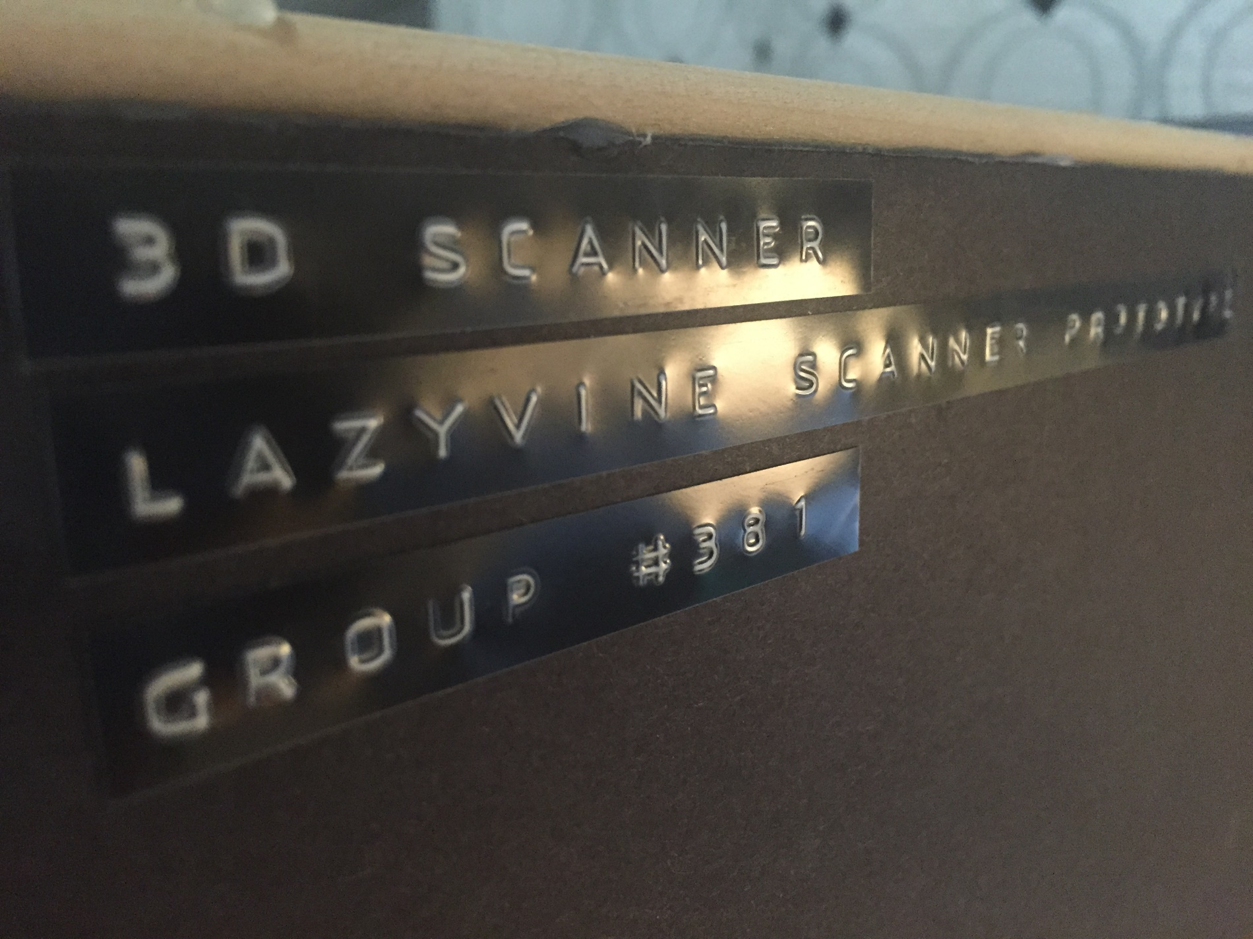
Implementation of a 3D Scanner
ECE496 - Capstone Project January 21, 2016 Group #381
Supervisor: Prof. Moshovos Administrator: Mr. Taglione
Presenters: Emily Miao, Grace (Jinghan) Guan, Sen Yang

Slide 2
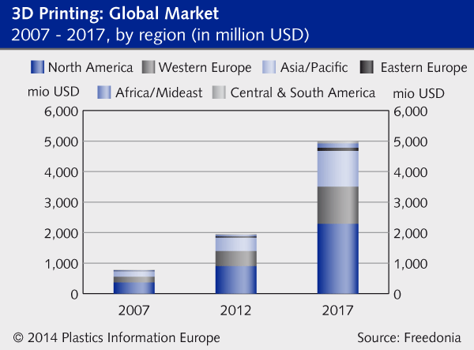
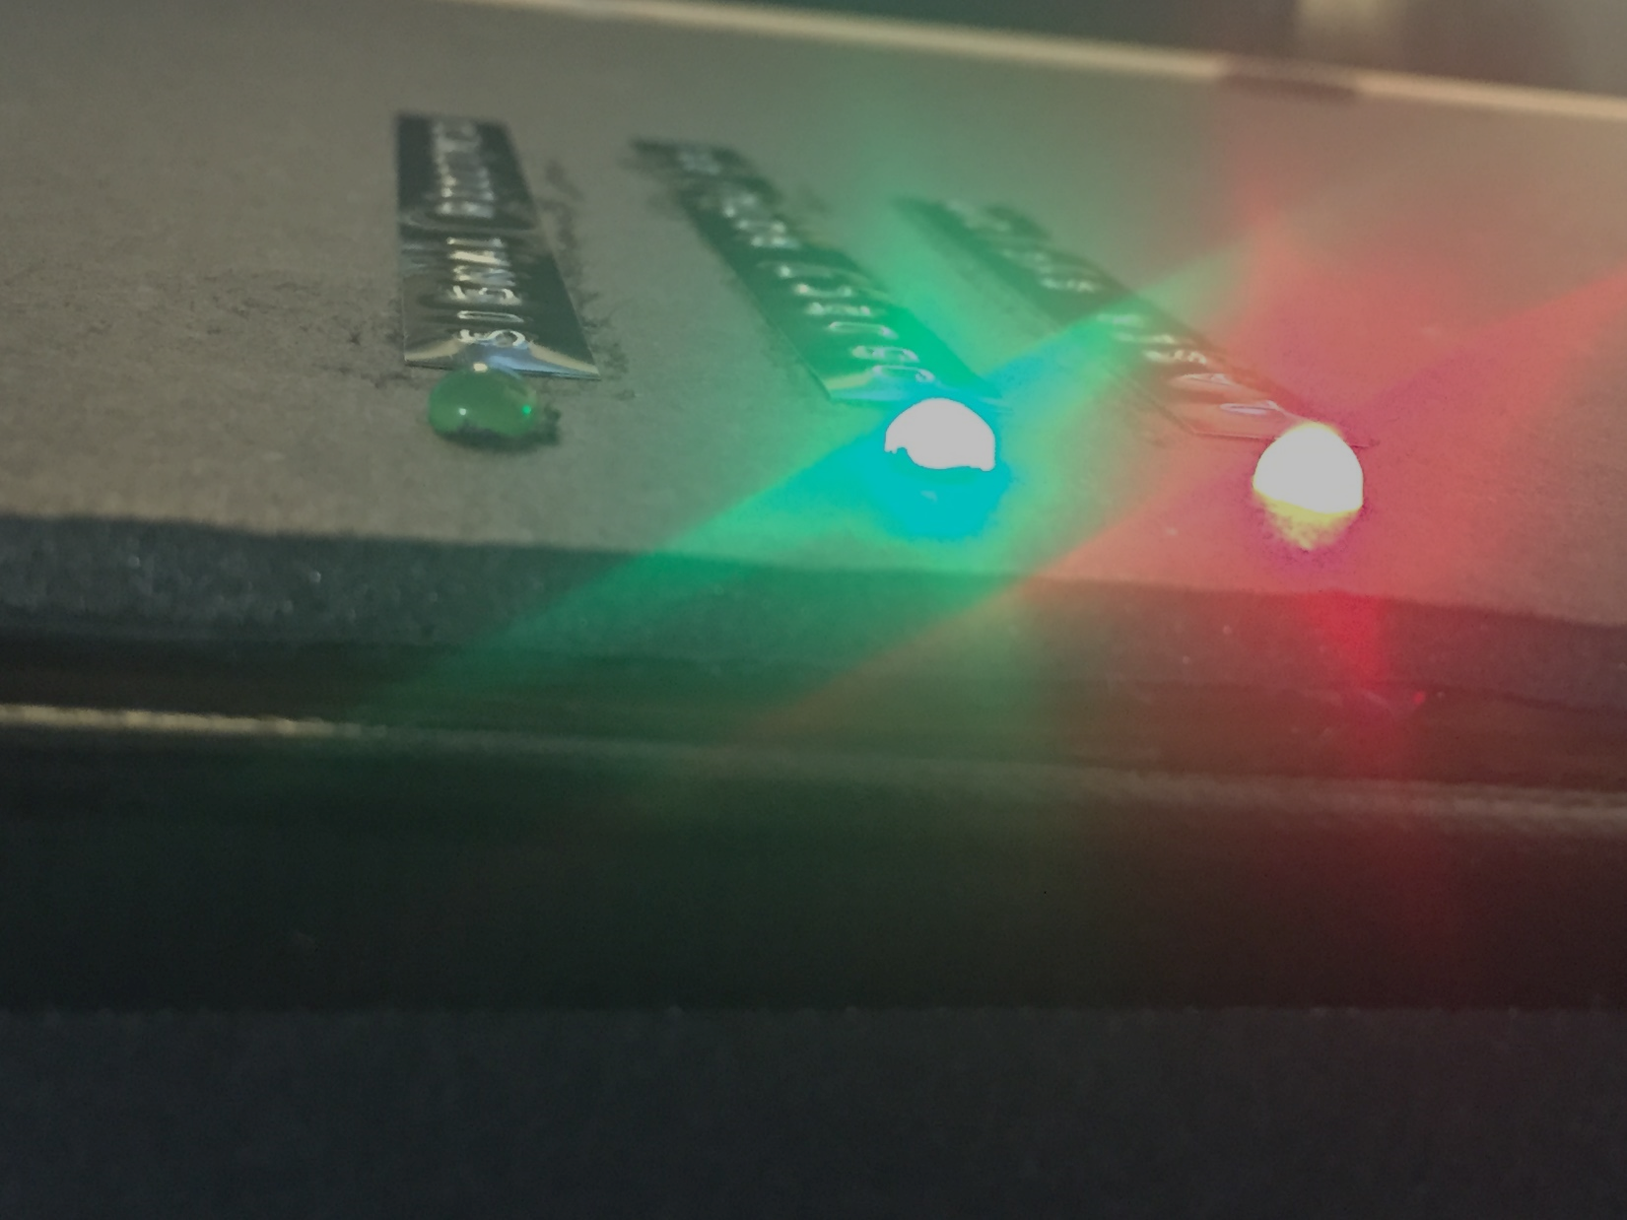
Notes:
[Project Background] <15s / 1 MIN> Consumer demand for 3D Modelling and 3D Printing grows tremendously. >5x market growth rate since the last decade. New scanners in various school labs, design labs.

Slide 3
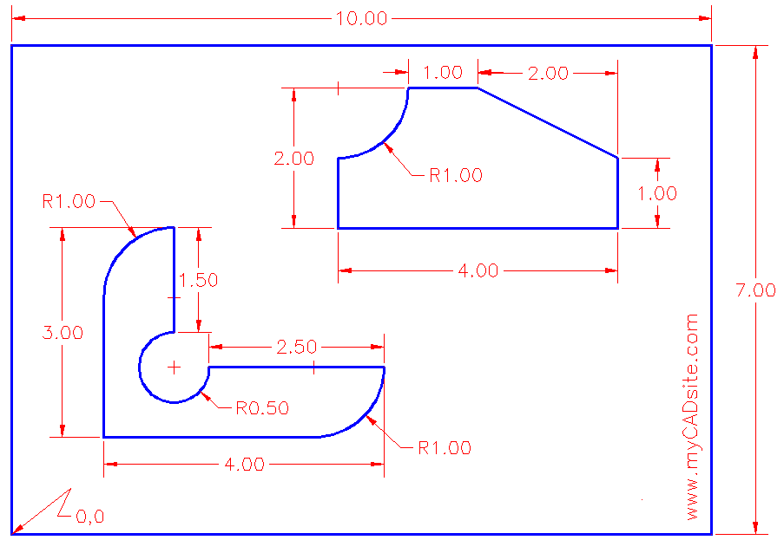
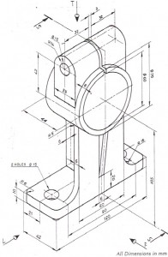
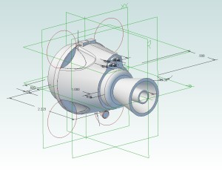
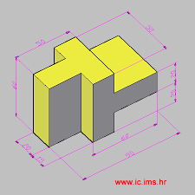
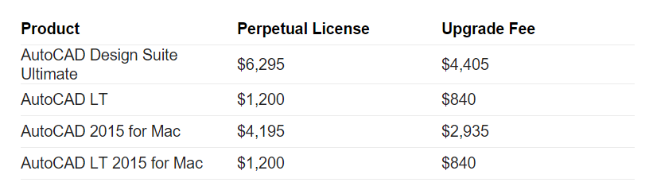
Images sourced from: Google Images, “3D CAD Sketch”, Cost Chart from: Google, “AutoCAD license cost”, accessed 2016.
Notes:
[Project Background] <15s / 1 MIN> CAD Models: Time consuming (takes hours to days for 3D model), requires lots of experience and expertise to create, requires expensive CAD software license fees. The mass general markets in need of fast, accurate, and affordable alternatives.

Slide 4
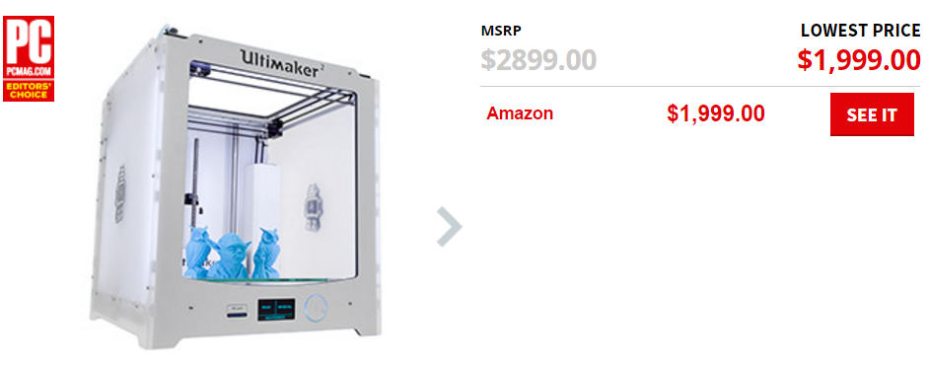
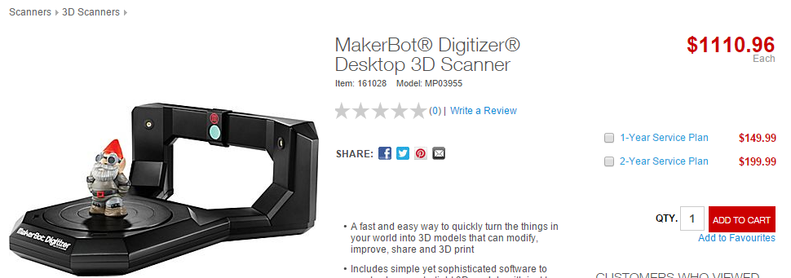
High End Scanners
Top: Sourced from pcmag.com. Bottom: sourced from staples.ca
Notes:
[Project Background] <10s / 1 MIN> High-end Consumer models are extremely expensive as investment for most users.

Slide 5
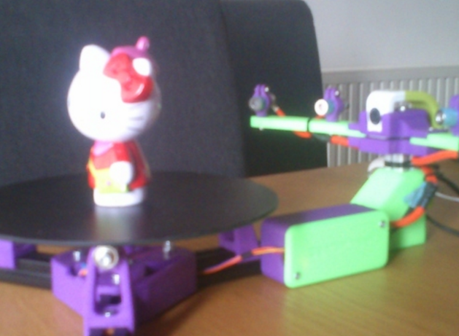
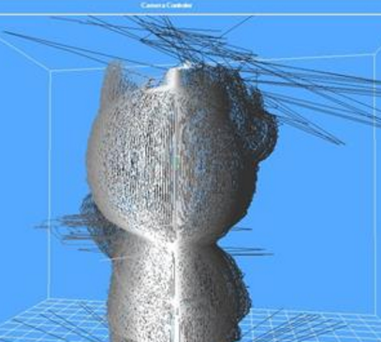
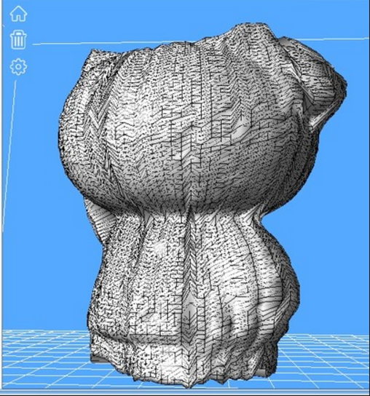
Low End / DIY Scanners
Sardauscan® DIY 3D Scanner
$30 – $50
Difficult to build
Requires technical knowledge
Error prone
Low detail
Lack automation
Sourced from Google Images: “Sardauscan 3d scanner”, 2016
Notes:
[Project Background] <15s / 1 MIN> Cheaper, but have poor quality. Requires tech know-how. Lacks product features, and not designed for 3D printing.

Slide 6
Project Objectives
“The end objective of this project is to implement a scanning system which observes a physical object of limited size and weight, and to digitally produce the corresponding 3D model files for monitor display and 3D printing…
… less than $50 per unit to mass produce ...
… straight forward to use, automated …”
– Final Project Proposal, Group #381, 2015
Notes:
[Project Background] <20s / 1 MIN> Recite “Project Objective”

Slide 7
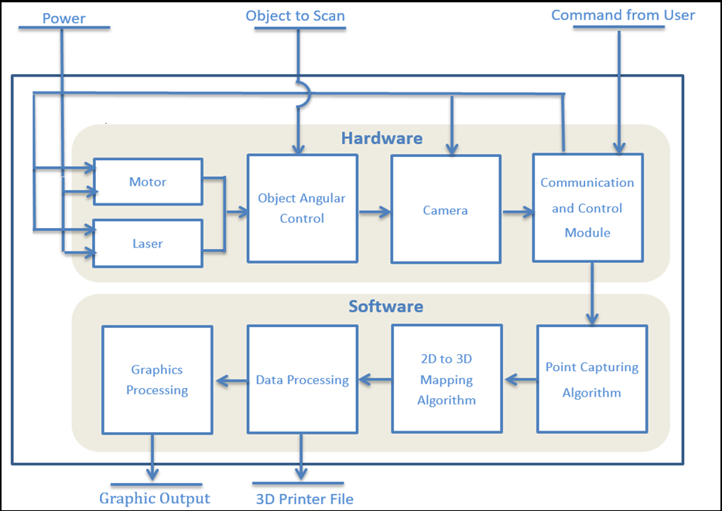
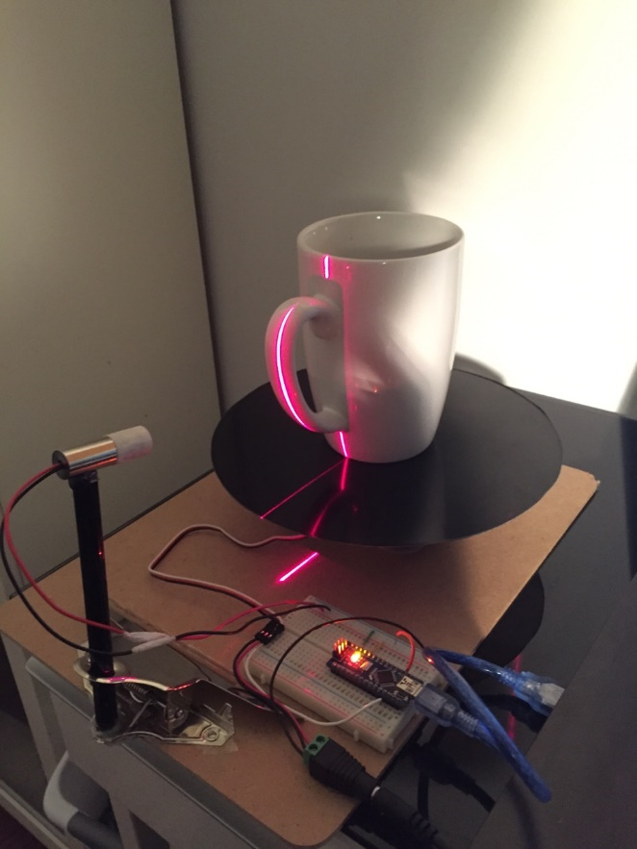
System Overview
System Overview, Final Project Proposal, Group #381
Prototype I – “The Clipboard”
Notes:
[System Overview] <50/75s> Explain on what the system requires as inputs. Explain what the system produces. Explain as overview on how each component is employed in this project. Use the first prototype as reference.

Slide 8
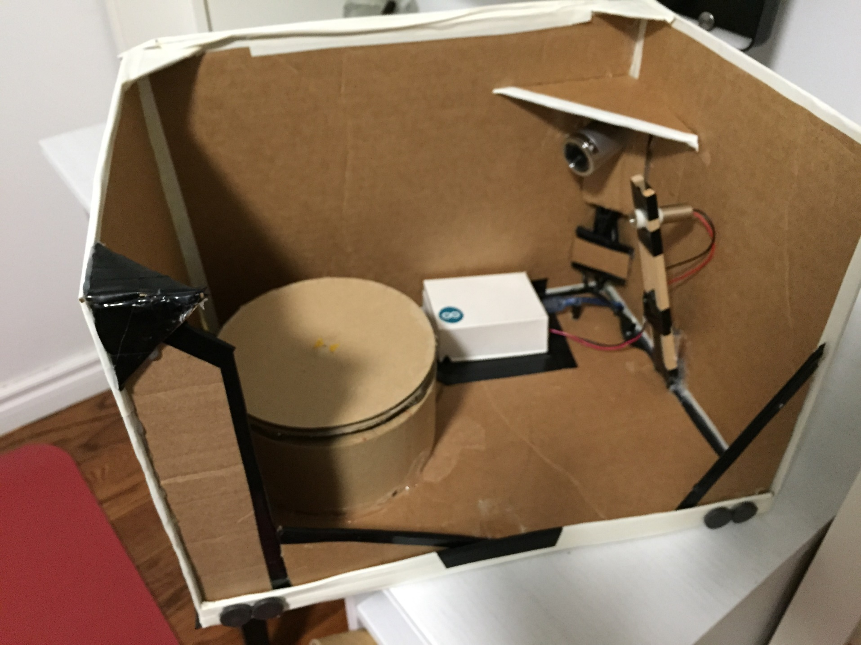
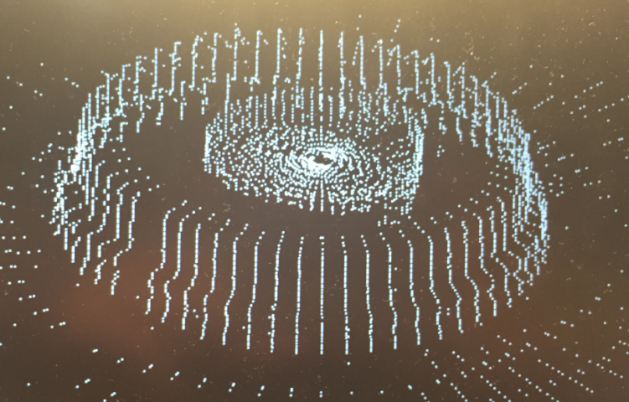
Project Hardware
Generated 3D cloud points
Limited scanning size
Fragile paper casing
Limited accuracy
Limited weight loading
Prototype II – “The Boardbox”
Scanned Coffee Lid
Notes:
[Proj. HW.] <30/ 180s> Review of P2, what does it do, features. Design lessons, go over weakpoints.

Slide 9
Prototype III - Lazyvine
Improving the 3D Scanner
Prototype I – “The Clipboard”
Prototype II – “The Clipboard”
Prototype III – “The Lazyvine”
Notes:
[Proj. HW.] <30/ 180s> P3 Jobs Speech. LOL….
Talk about things to improve, and what P3 aims to accomplish.

Slide 10
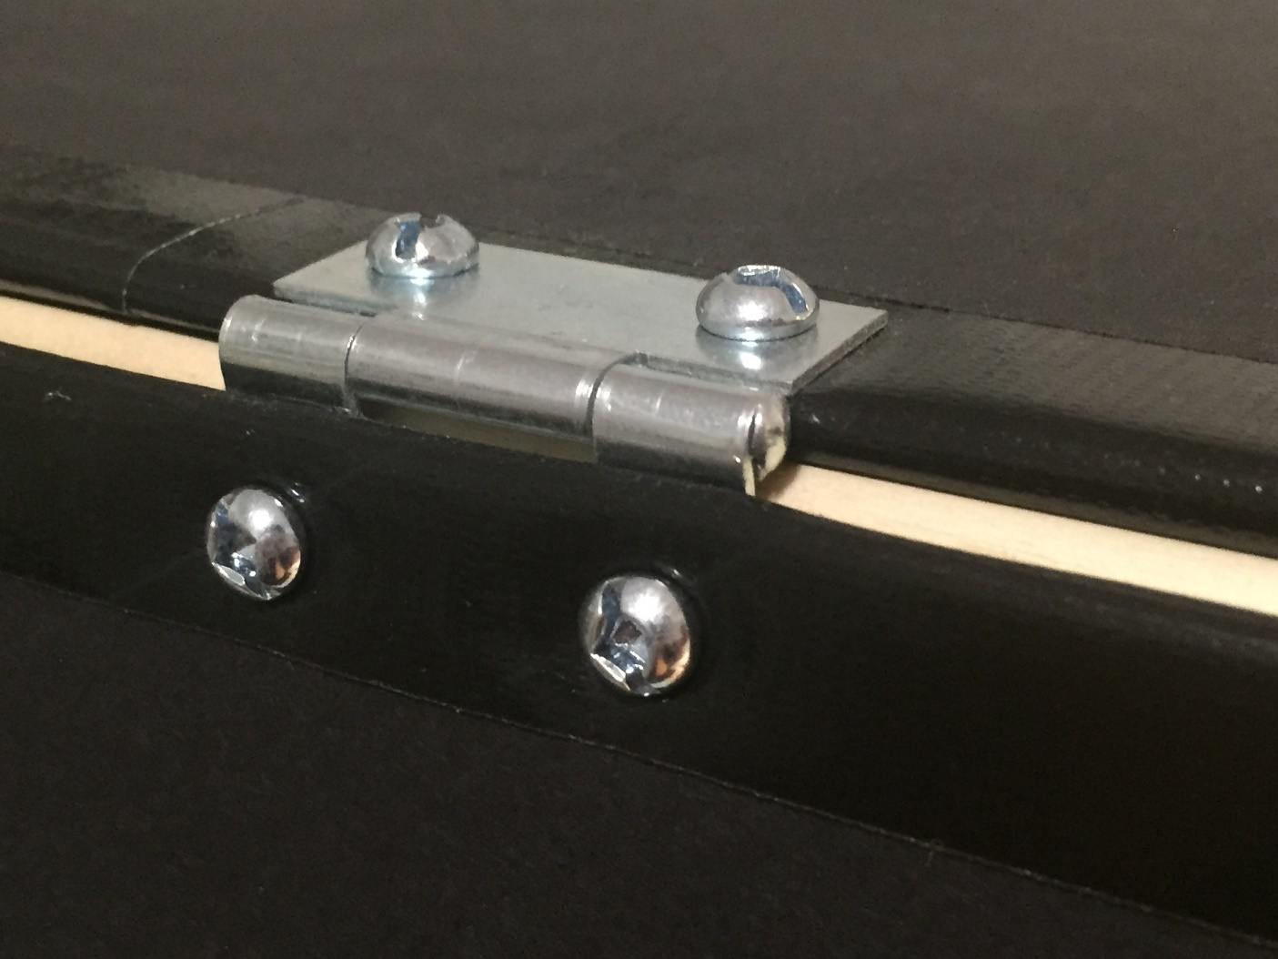
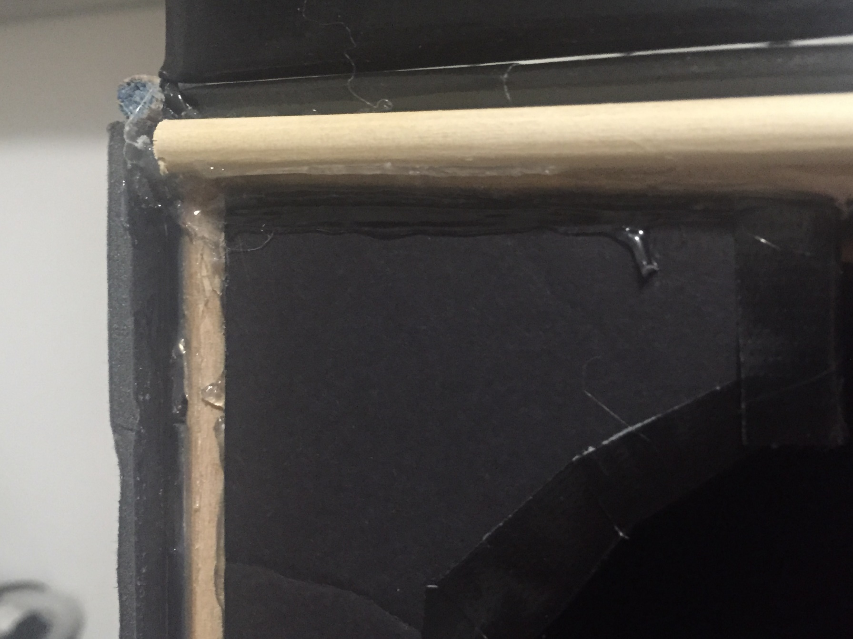
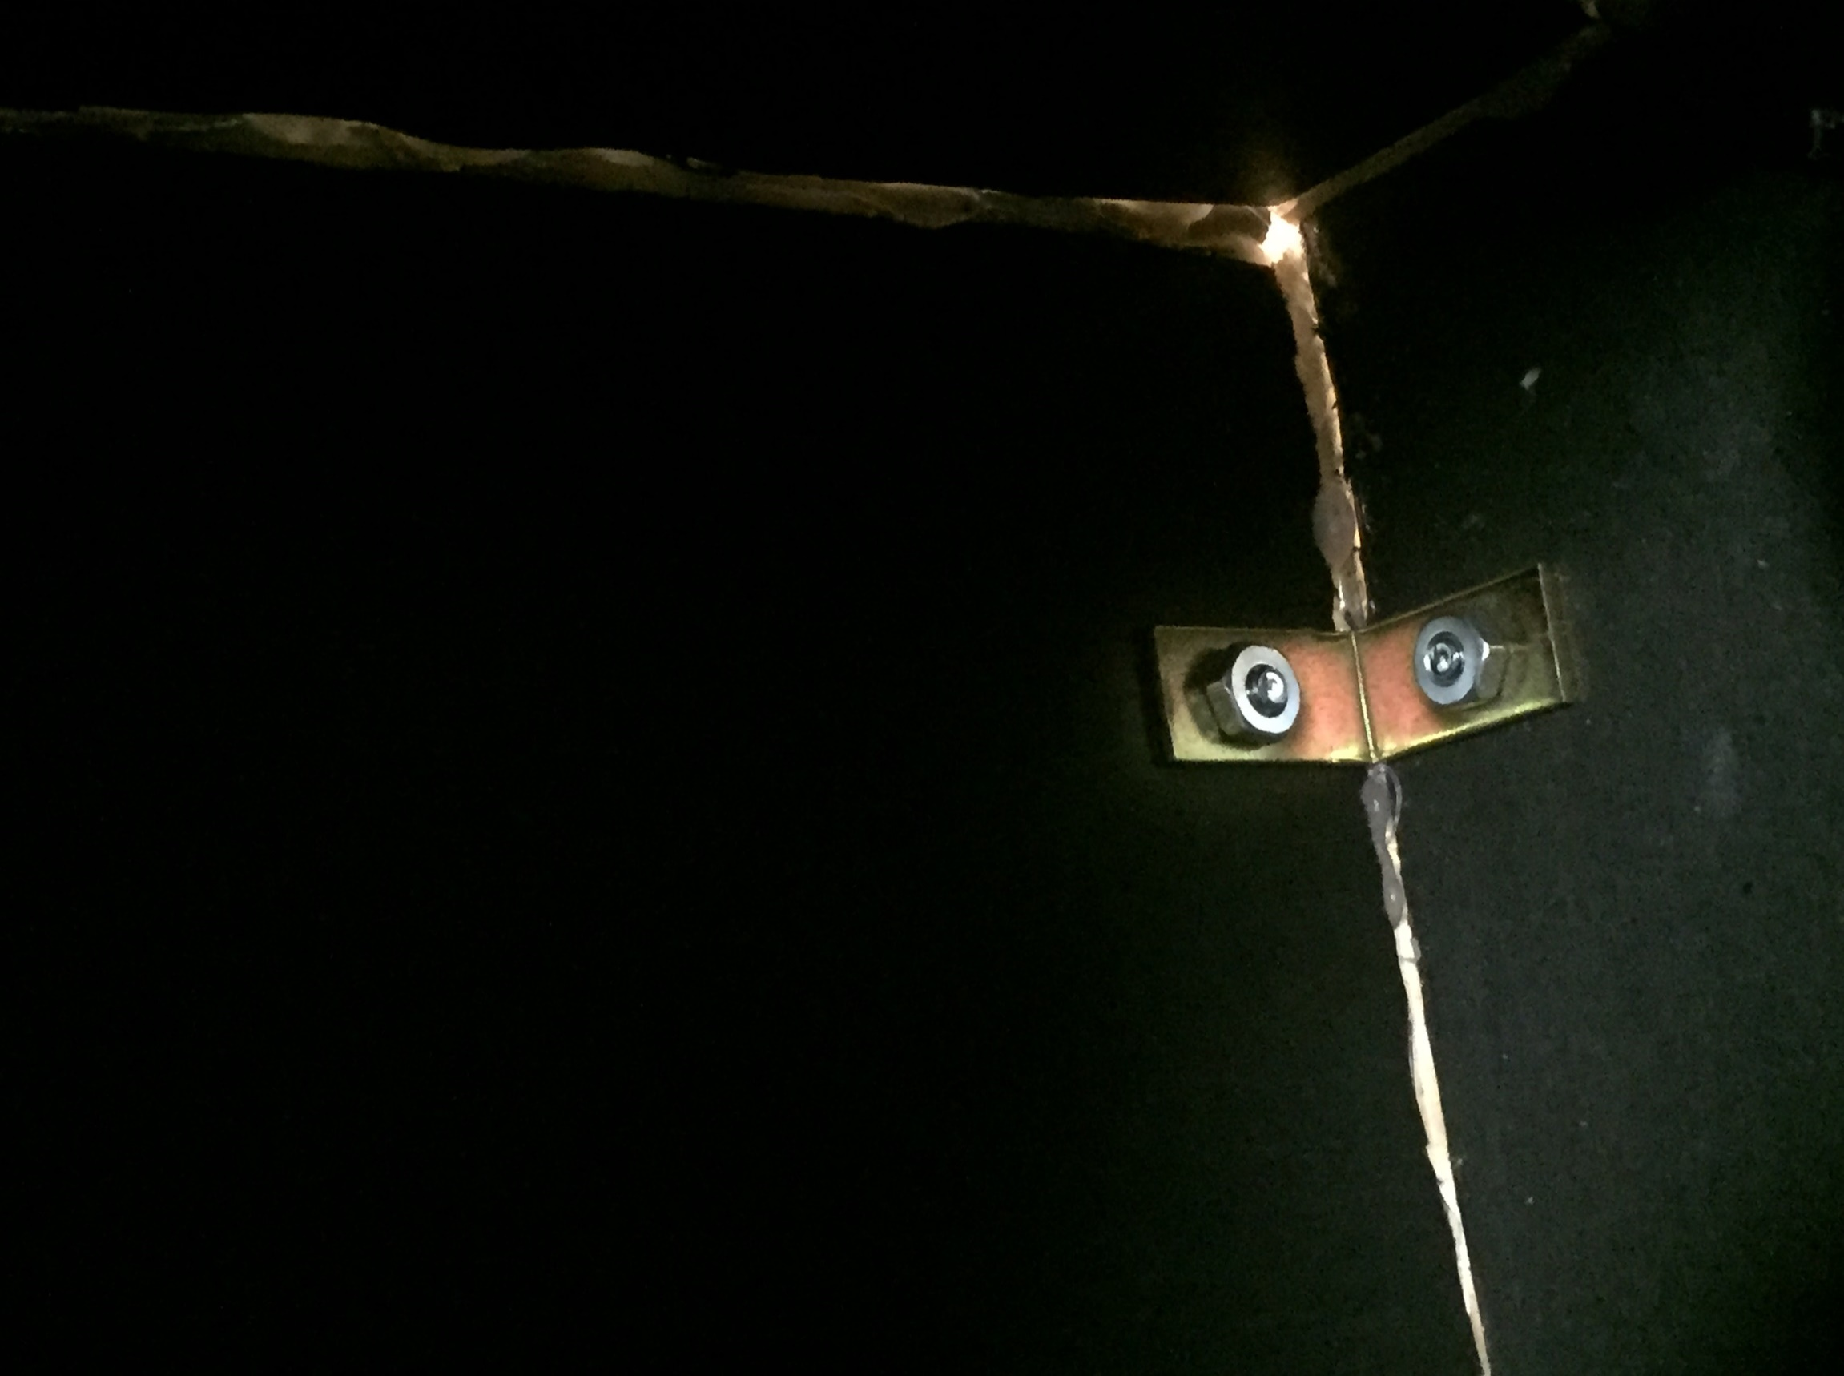
Improved Durability

Slide 11
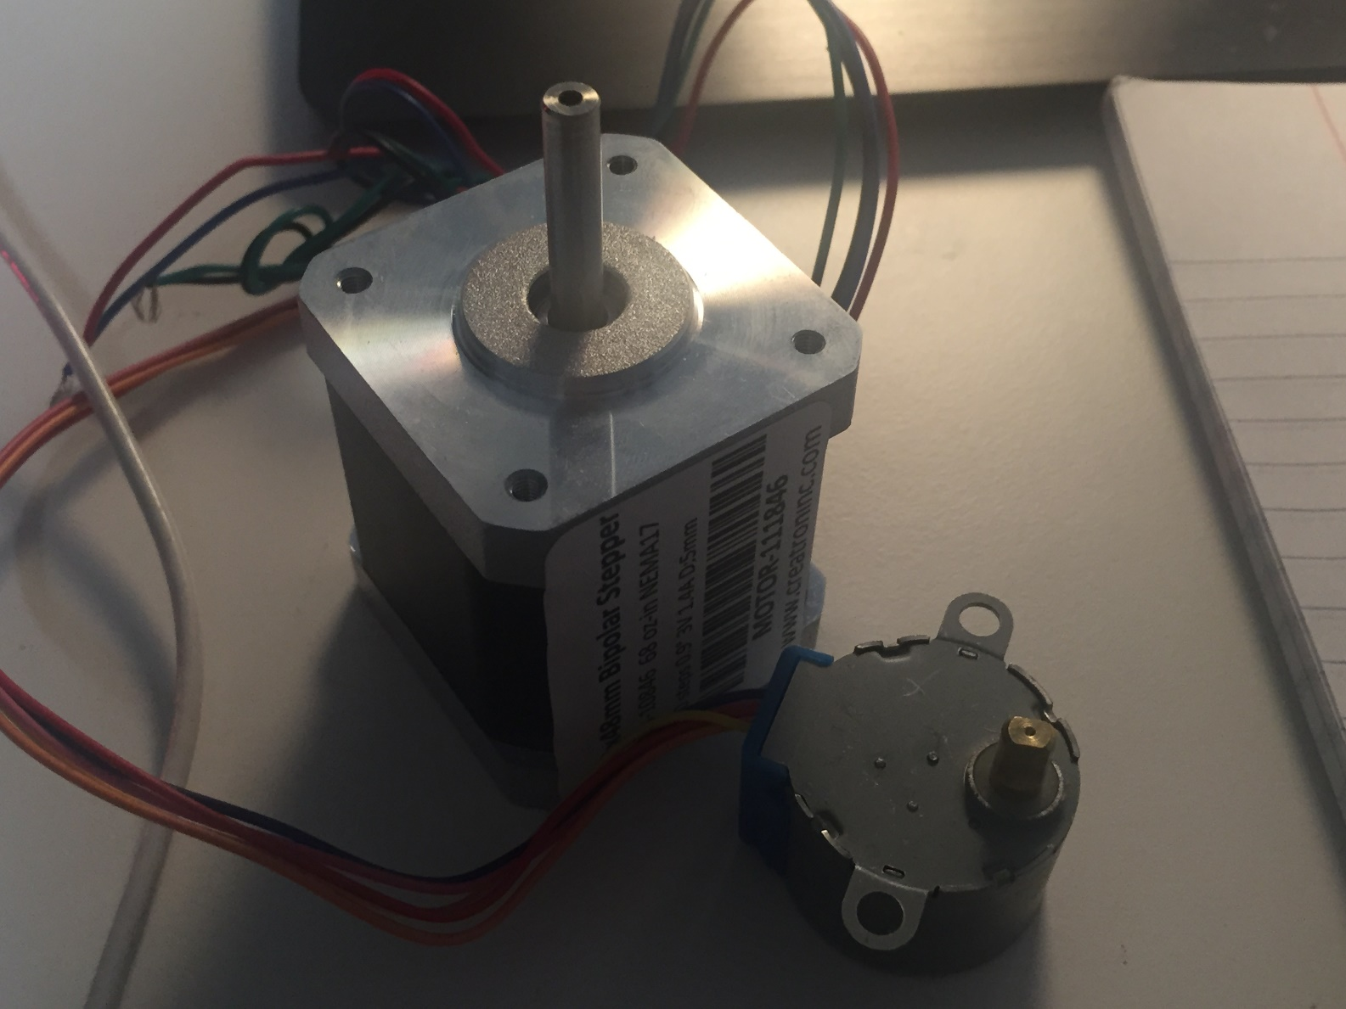
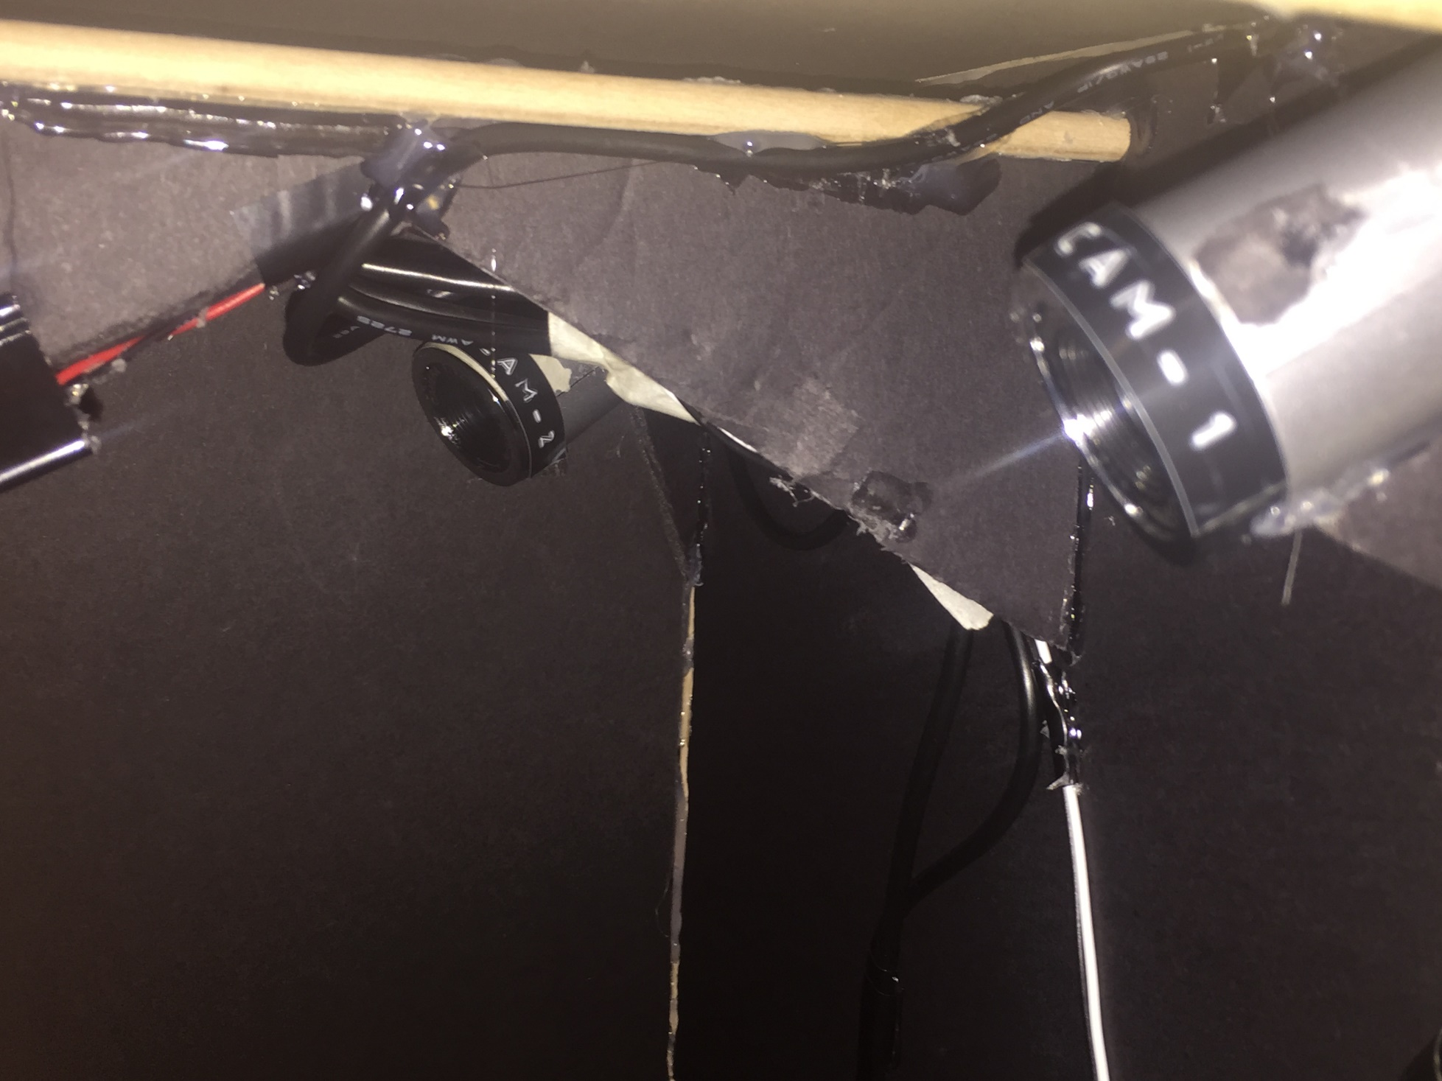
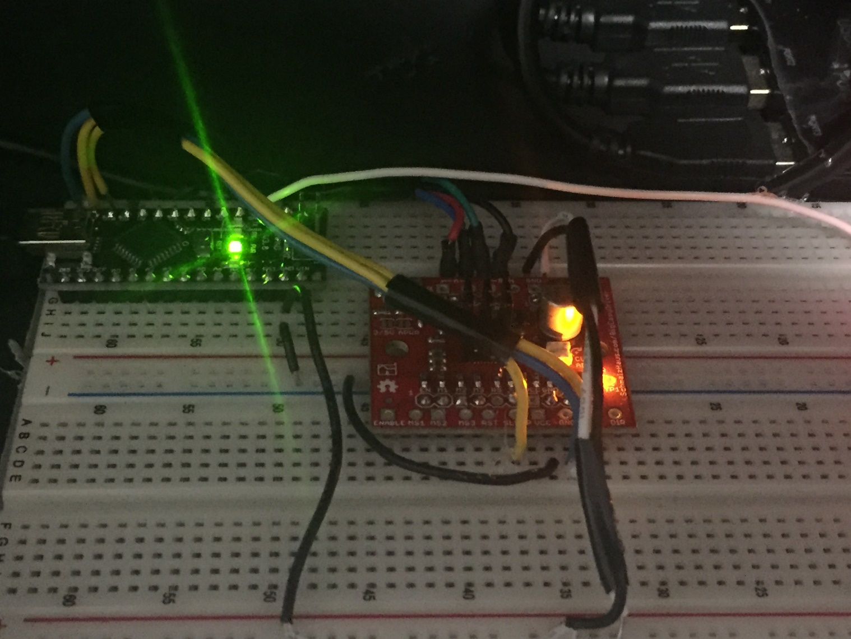
Improved Definition

Slide 12
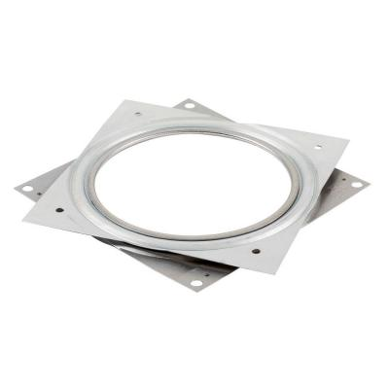
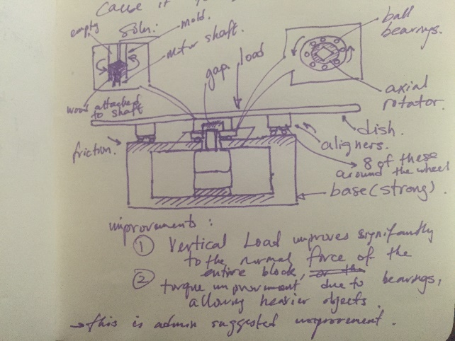
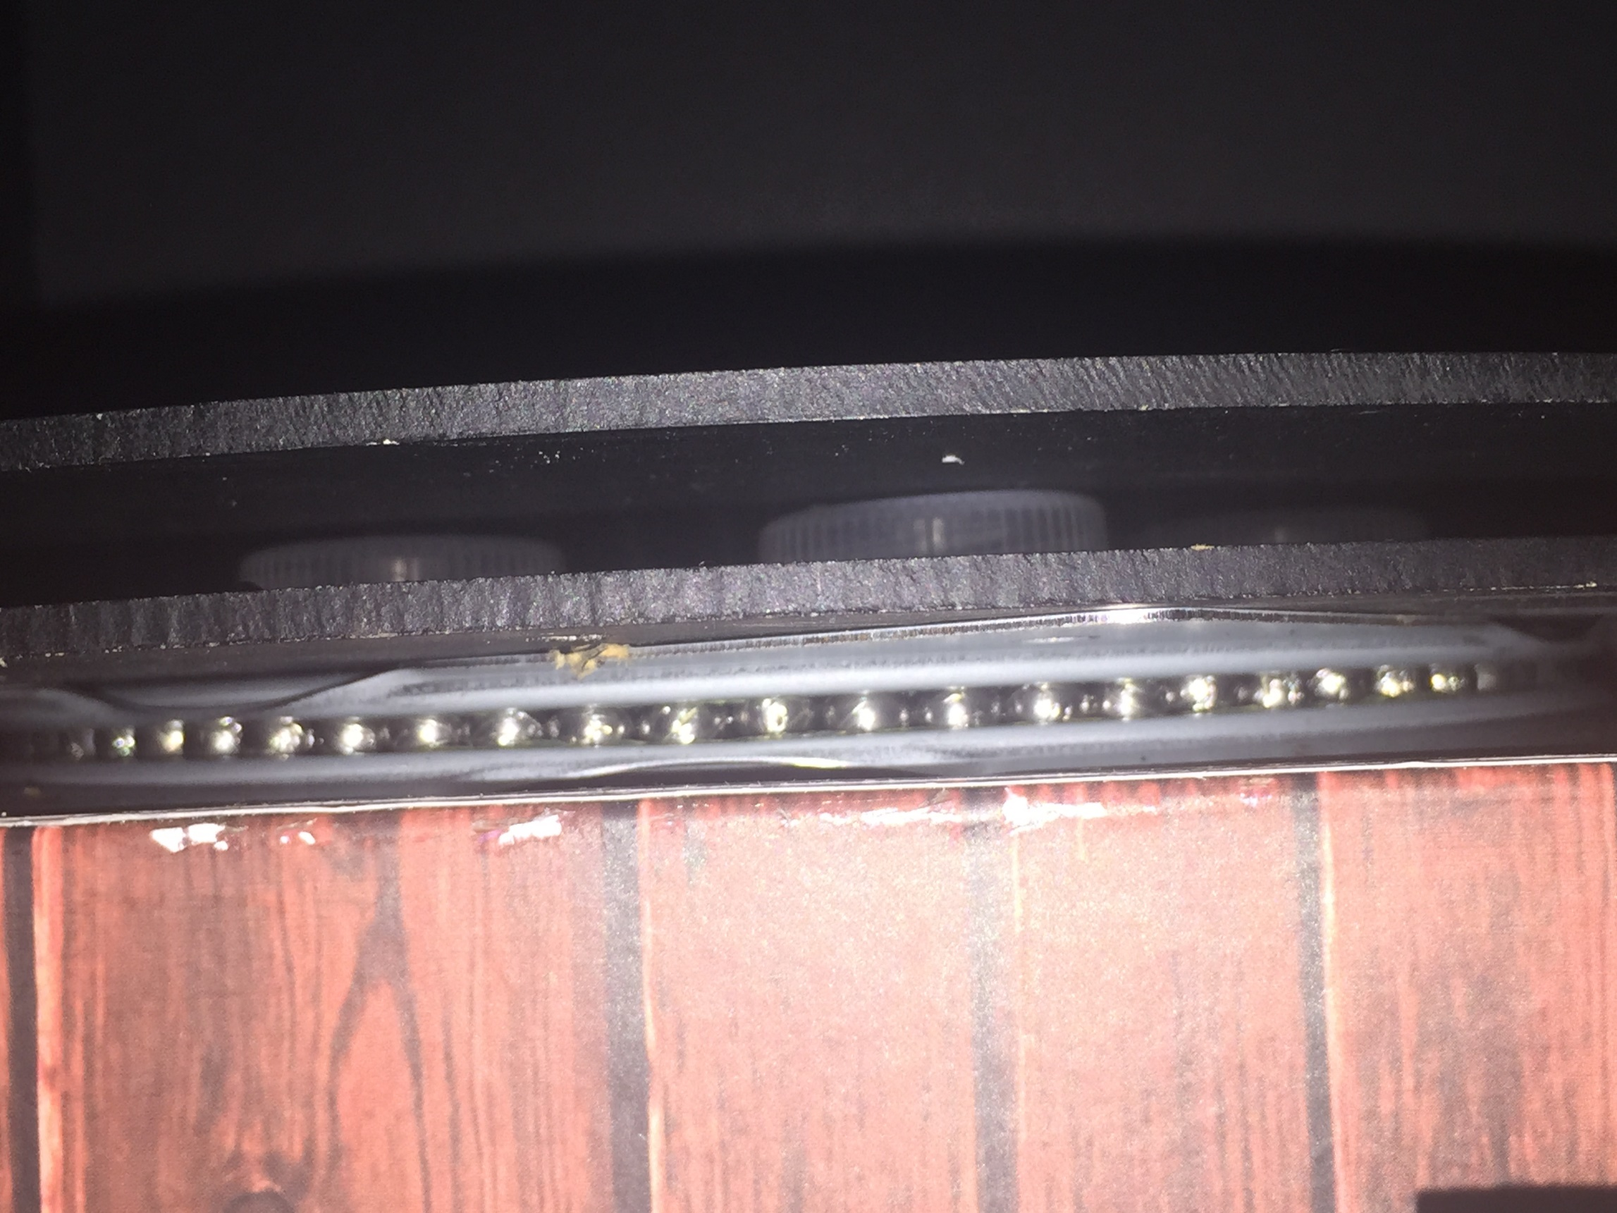
Revolutionary Weight Loading System

Slide 13
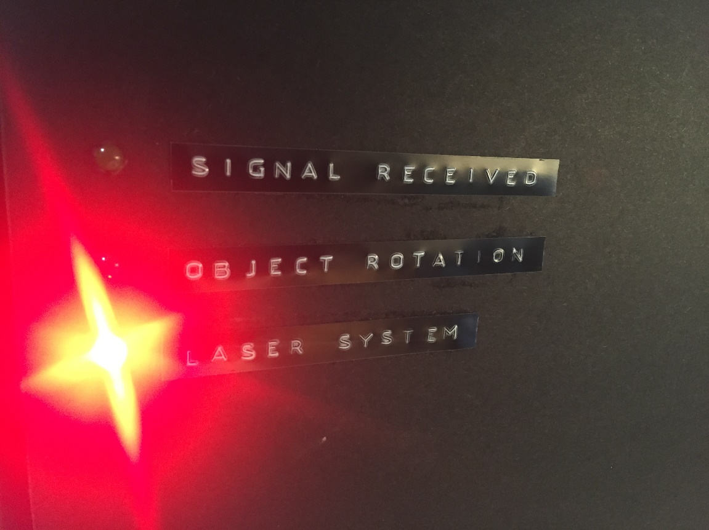
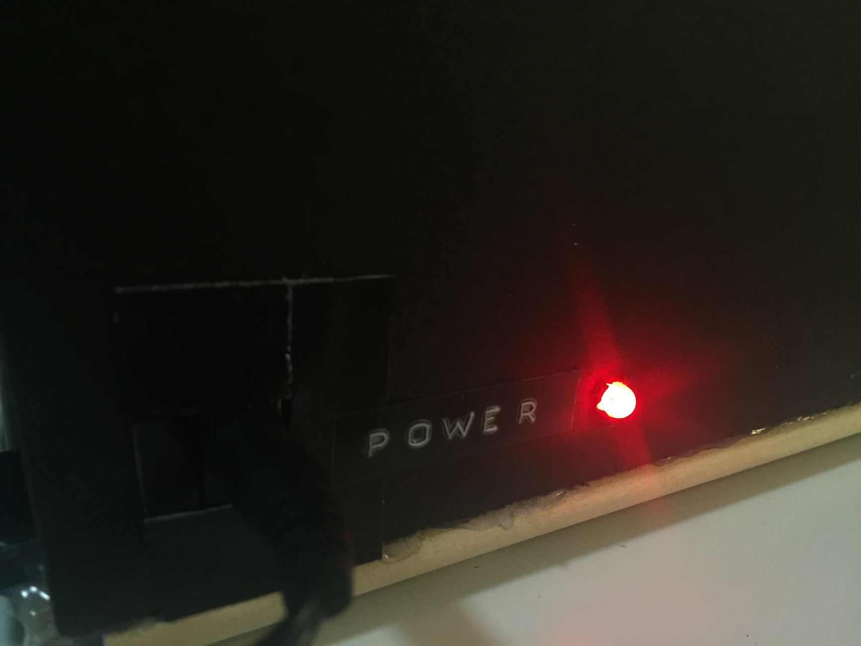
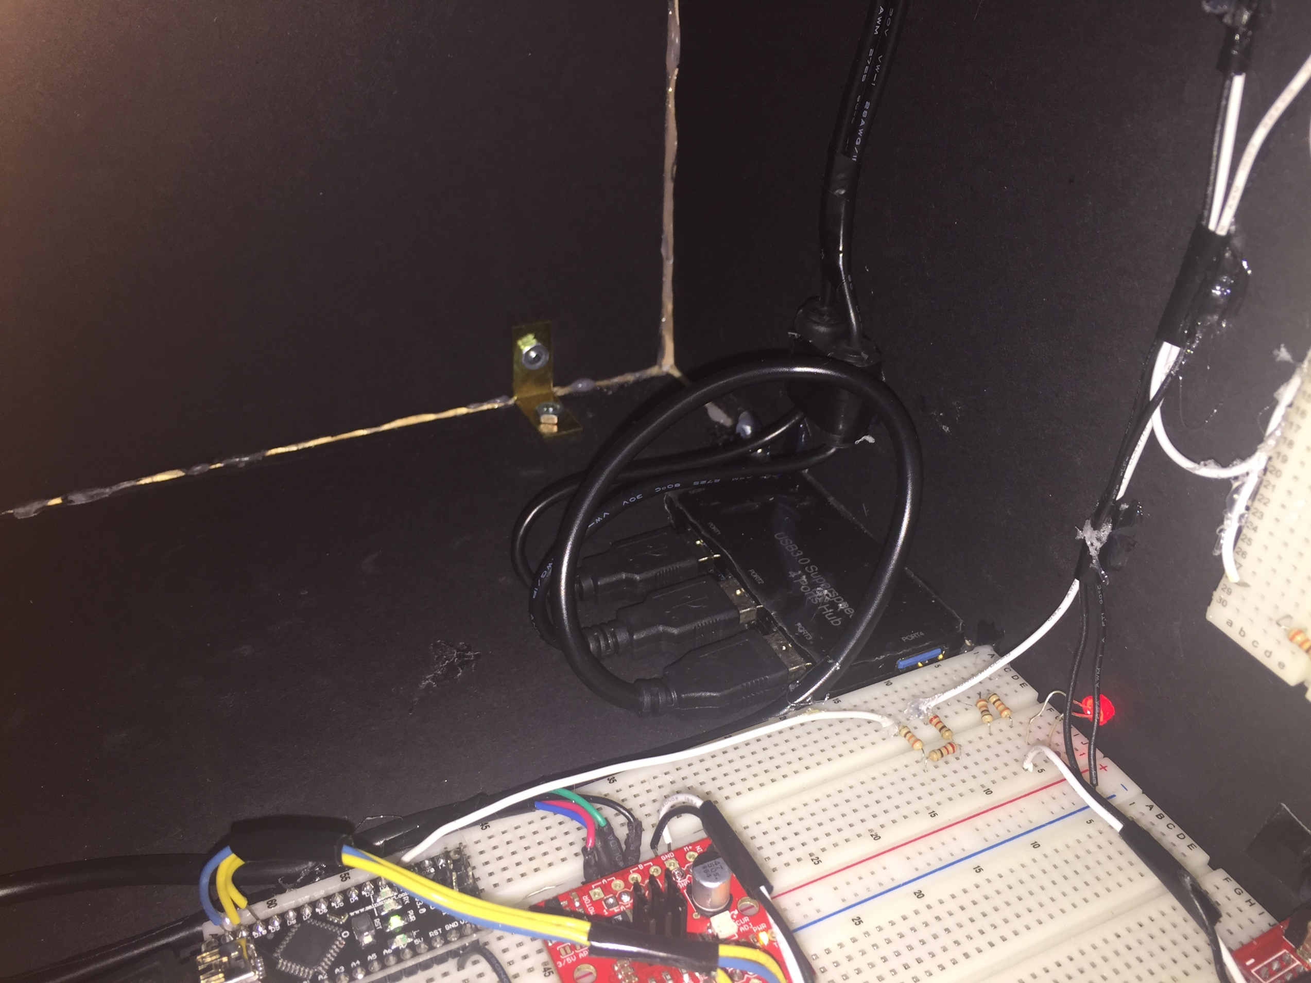
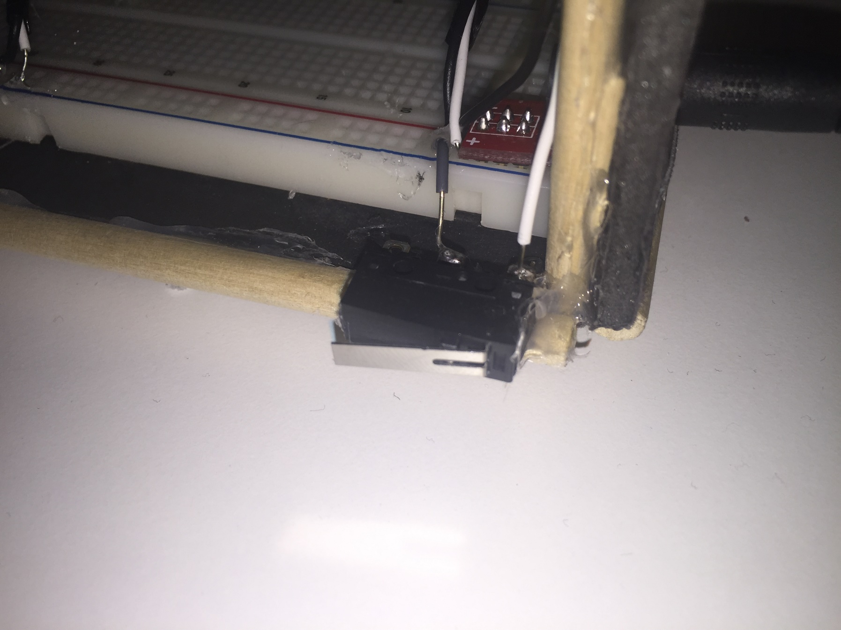
Improved Features
Notes:
[Proj. HW.] <30/ 180s> P3 Jobs Speech. LOL….
Talk about things to improve, and what P3 aims to accomplish.

Slide 14
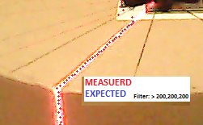
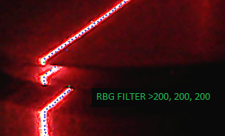
Points Extraction

Slide 15
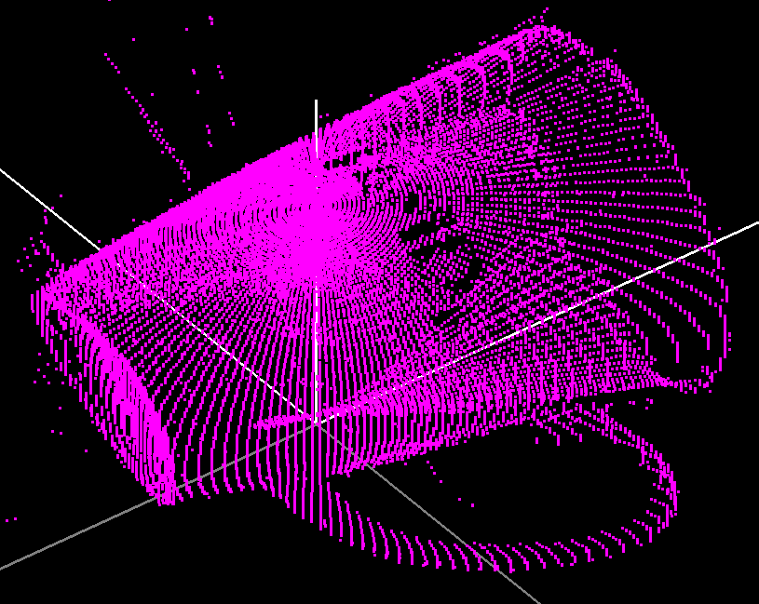
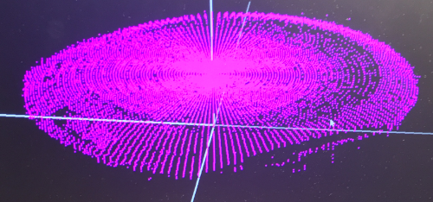
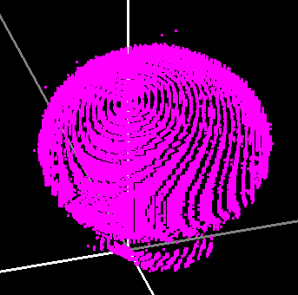
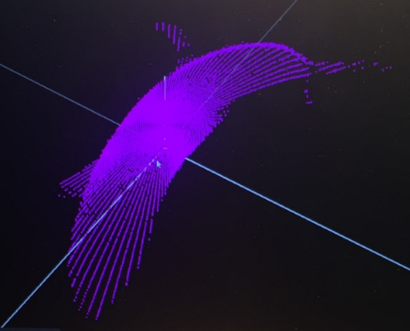
3D Point Mapping

Slide 16
Demo
Demo: Object Digitization

Slide 17
Demo
Demo: Illustrator Program and Points Meshing

Slide 18
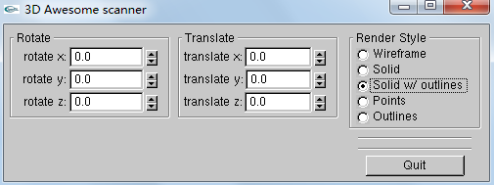
Demo

Slide 19
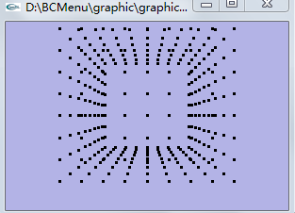
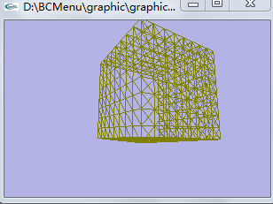
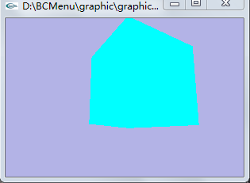
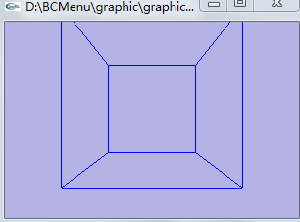
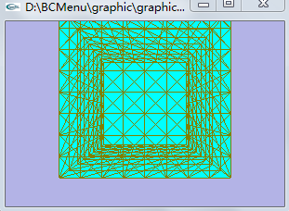

Slide 20
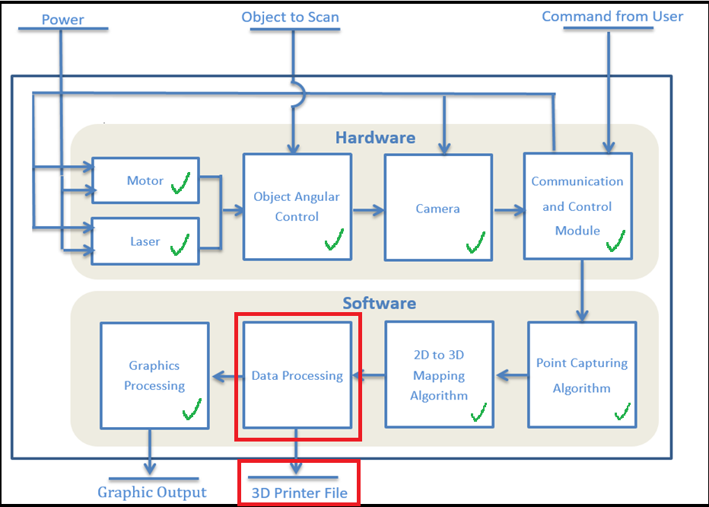
Project Roadmap
Produced accurate 3D point cloud
Improved prototype performance
Completed 3rd prototype
Reduce scanner “blindspots”
Convert 3D point cloud points to printer files (.STL, .OBJ)
System Overview, Final Project Proposal, Group #381
Notes:
[System Overview] <25/75s> Talk about current status, and work still needs to be done. Go over the roadmap.

Slide 21
Q & A

